Slide 1
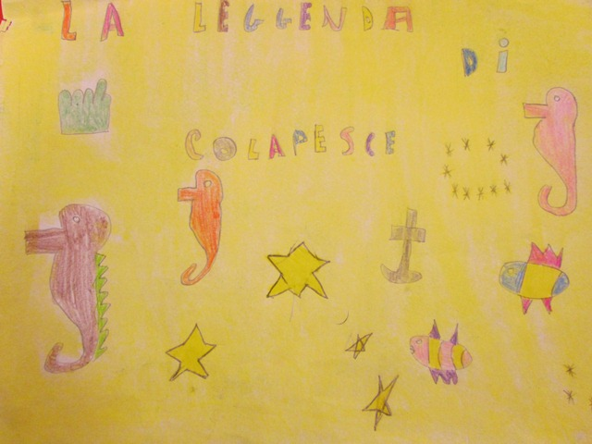
0
The story from Iceland Made by classes 3 and 4

Slide 2
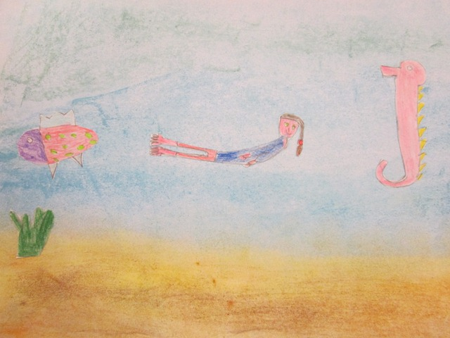
Once upon a time there was a girl named Sara. She was svimming in the ocean with the fishes. She cought the fishes she was swimming with.

Slide 3
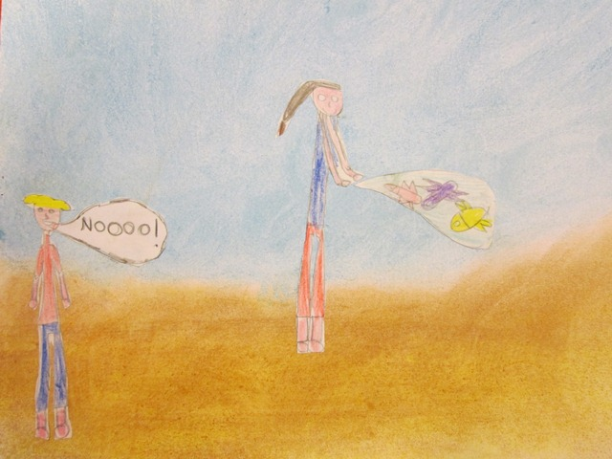
When she came from the ocean she was carrying a bag with the fishes. On the beach she met a boy named Palli. He said to Sara : Nooo you can ´t do that and Sara said why not who is going to say that I can´t. Everyone said Palli. Alright said Sara. I will go out to the ocean on a boat and free the fishes. That is good said Palli

Slide 4
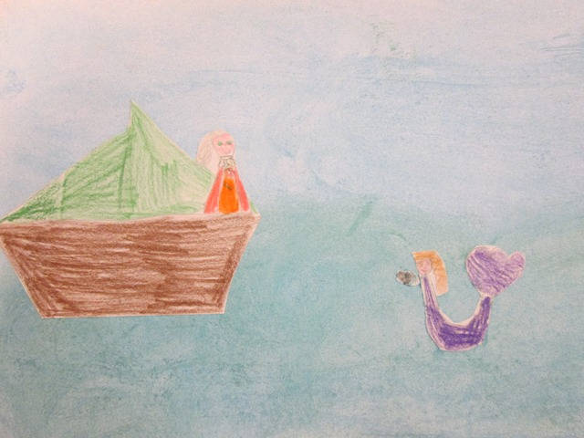
Sara took the boat and sailed to the see and freed the fishes. But suddenly she saw a mermaid who swam to the boat. The mermaid said to Sara. You have to help me save the palace. Who... me said Sara. Yes you are so brave said the mermaid. What can I do to save the palace said Sara.

Slide 5
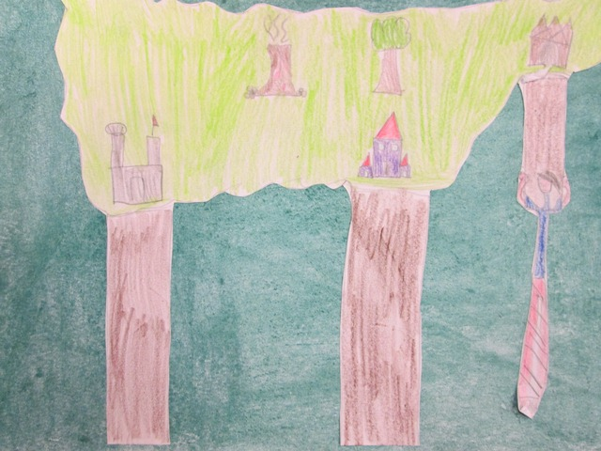
You have to swim straight ahead and then turn left. What shall I do there said Sara. The palace stands on an Island which has three big wooden stick. One of the wooden stick is broken and you are such a good swimmer and very strong and you are the only one who can save us. All right I will help you said Sara. She swam to the broken wooden stick and she fixed it. All the mermaids were very glad. Sara went home and she said to here self !“ I will never harm the fishes again“.
Everybody were happy.

